Slide 1

DyPyBench A Benchmark of Executable Python Software
Master Thesis Project of Piyush Bajaj
Examiner: Prof. Dr. Michael Pradel
Supervisor: Islem Bouzenia

Slide 2
Introduction : Background and Motivation
Why Python is a prime candidate for dynamic analyses ?
Popularity.
Dynamism.
What are benchmarks ?
How do benchmarks help in dynamic analyses ?
Are there any existing dynamic benchmarks ?
SPEC benchmarks. (https://www.spec.org/benchmarks.html)
DaCapo Benchmark. (https://www.dacapobench.org/)
We choose Python since it does not have a dynamic benchmark.

Slide 3
Introduction : Challenges
Large number of available Python projects.
Which to choose?
Diverse domains of Python projects.
How to classify the application domain?
Differences in setup and installation of projects.
How to handle different libraries, dependencies and steps?
Execution of projects.
How to ensure execution?
Longevity and Accessibility.
How to ensure it is accessible and available for a long time?

Slide 4
Introduction : Proposed Solution
Solve the challenges to create a general purpose dynamic benchmark to perform dynamic analyses.
Dynamic benchmark should have the following properties:
Large-scale.
Diverse.
Ready to Run.
Ready to Analyze.
Extensible.
Long-term.
Compositional.

Slide 5
Introduction : Concrete steps
Collect a set of 50 popular and diverse python projects with test suites.
Integrate analyses tools into the execution environment.
Design and implement a unique interface to execute and perform dynamic analyses of Python projects.
Evaluate the usefulness of the dynamic benchmark for two different applications.

Slide 6

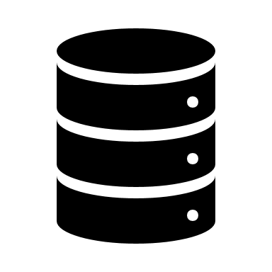


Approach
Usage of DyPyBench
Selection Criteria
Test Suite,
Diverse domains,
GitHub stars
Installation of Projects
Automation,
Environments,
Requirements
Integrating Analysis Frameworks and
LExecutor
DynaPyt,
PyCG
LExecutor
Trace File Generation
DynaPyt
Dynamic Analysis
Corpus of Python projects Awesome Python
List of Python Projects
GitHub URLs,
flags
Execution Environment
Installed Projects
Access Interface
List Projects, Run Tests, Run Analysis
Static
Call Graphs
PyCG
DyPyBench

Slide 7
Approach : Corpus of Python Projects (1)
Popular and open source projects.
Collection of Python projects.
Awesome Python. (https://github.com/vinta/awesome-python/)
Awesome Python Applications. (https://github.com/mahmoud/awesome-python-applications)
Python Projects. (https://github.com/practical-tutorials/project-based-learning)
Awesome python provides a large set of projects.
Projects from different application domains defined by awesome python categories.

Slide 8
Approach : Corpus of Python Projects (2)
Overall Projects : 679
Type of Projects : Frameworks, Libraries, Software
Main Categories : 92
Top 10 categories and the number of projects in them:
Category | No. Of Projects
Testing | 30
Text Processing | 22
Science | 21
Code Analysis | 18
Debugging Tools | 18
Category | No. Of Projects
Specific Formats Processing | 18
Command Line Tools | 17
GUI Development | 16
Database Drivers | 15
Image Processing | 15

Slide 9
Approach : Selection Criteria (1)
Diverse domain.
Machine learning, Web development, GUI development, etc.
One category, one project from Awesome Python.
GitHub stars.
Community accepted projects.
At least 500 stars.
Test suite execution.
Integrated test suites.
Test suite compatible with pytest.

Slide 10
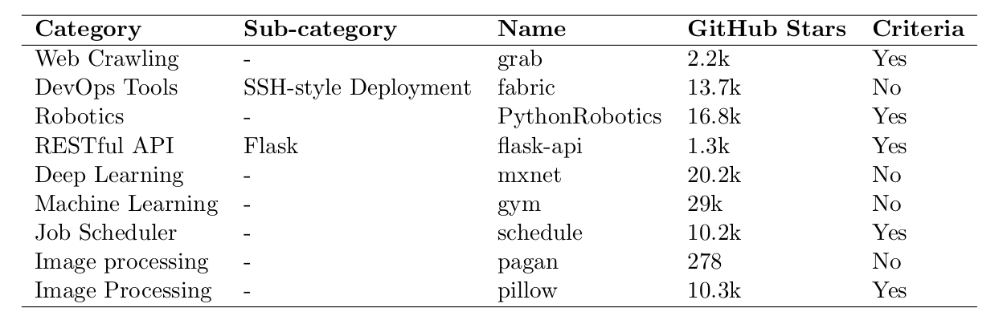
Approach : Selection Criteria (2)
2
10 projects from Awesome Python

Slide 11
Approach : List of Python Projects (1)
Python Robotics
Flask-Api
git clone https://github.com/AtsushiSakai/PythonRobotics.git
virtualenv vm
source vm/bin/activate
pip install .
pip install -r requirements/requirements.txt
pip install pytest
pytest tests/
git clone https://github.com/flask-api/flask-api.git
virtualenv vm
source vm/bin/activate
pip install .
pip install pytest
pytest flask_api/tests
Differences in setup, install and test execution

Slide 12
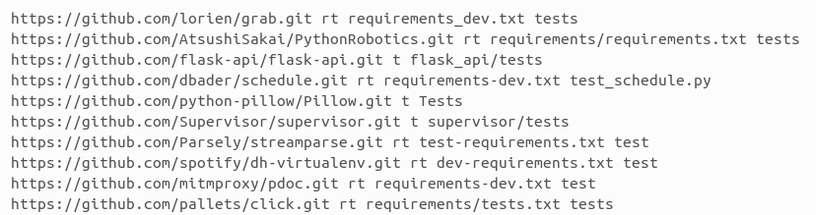
Approach : List of Python Projects (2)
Text file with list of project URL and flags

Slide 13
Approach : Installation of Projects (1)
List of projects + Bash script = Automation of installation.
Automation steps
Clone the project from Git with a fixed date to a sub-folder with GitHub URL flag.
Create and activate a virtual environment in the sub-folder.
Install project from source.
If requirements flag is 'rt', install dependencies from requirements file.
Else install test dependencies if specified in bash script.
Install pytest.
Deactivate virtual environment.
Repeat the above steps for all entries in the list and then overwrite test files.

Slide 14
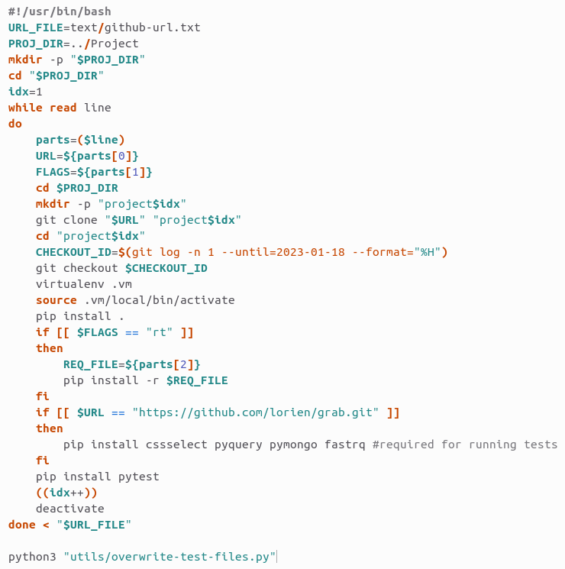
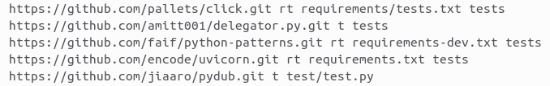
Approach : Installation of Projects (2)
github-url.txt

Slide 15
Approach : Execution Environment (1)
50 installed python projects.
Dependencies installed.
0 failed test cases.
Test suite execution with pytest.
Ready to run and analyze with a duplicate copy of the project.

Slide 16
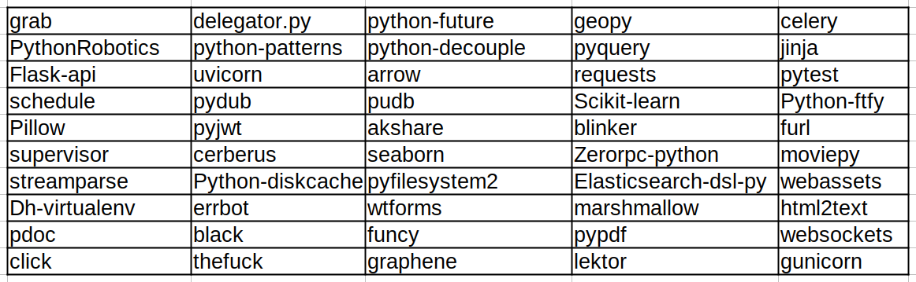
Approach : Execution Environment (2)
Geolocation
Job Scheduler
Data Validation
Web Content Extracting
GraphQL
50 projects in DyPyBench

Slide 17
Approach : Integrating Tools (1)
LExecutor
A neural model to predict input values to execute arbitrary code snippets.
We generate training data for the neural model in the form of trace files.
Two steps:
Instrumentation of files.
Execution of test suite.
Command for each step in a separate bash script.
Instrumentation files provided via text file.

Slide 18
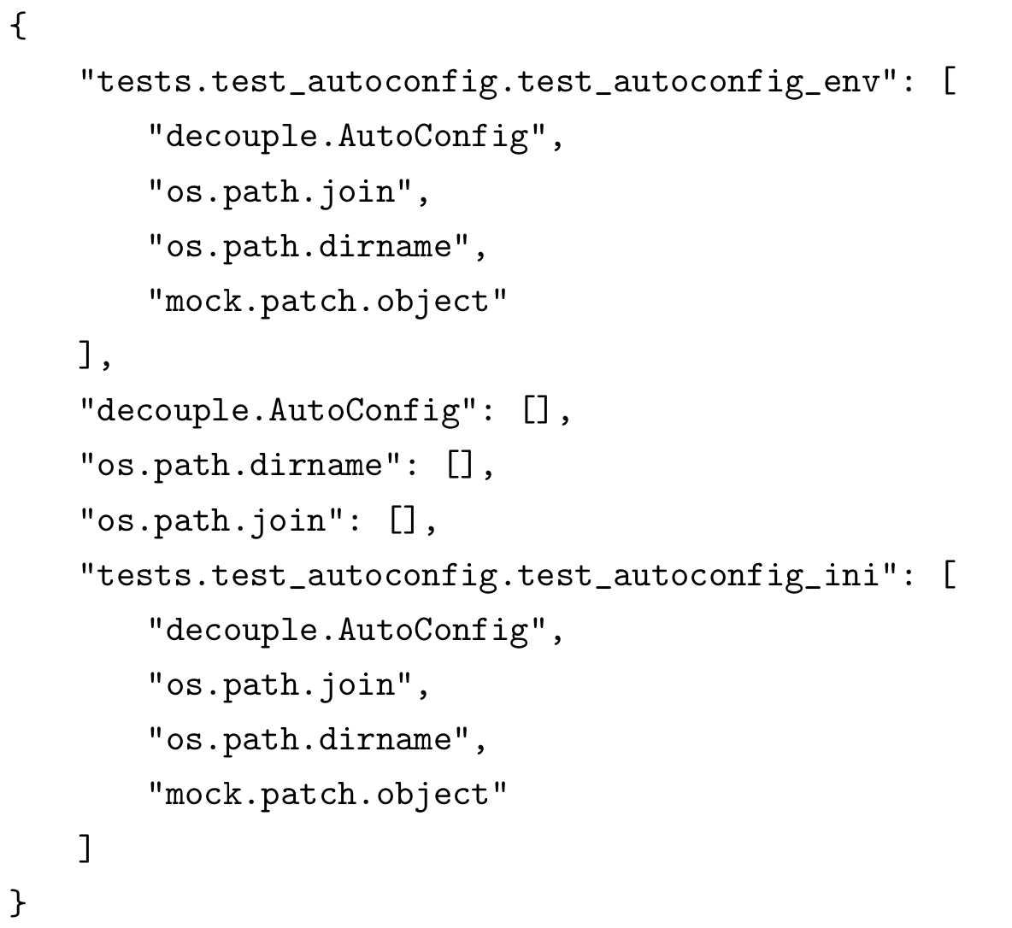
Approach : Integrating Tools (2)
PyCG
A call graph generation tool for Python based on static analysis.
We generate static call graphs in the form of JSON file.
Caller functions act as key and callees act as values.
Command to generate JSON file called via a bash script.

Slide 19
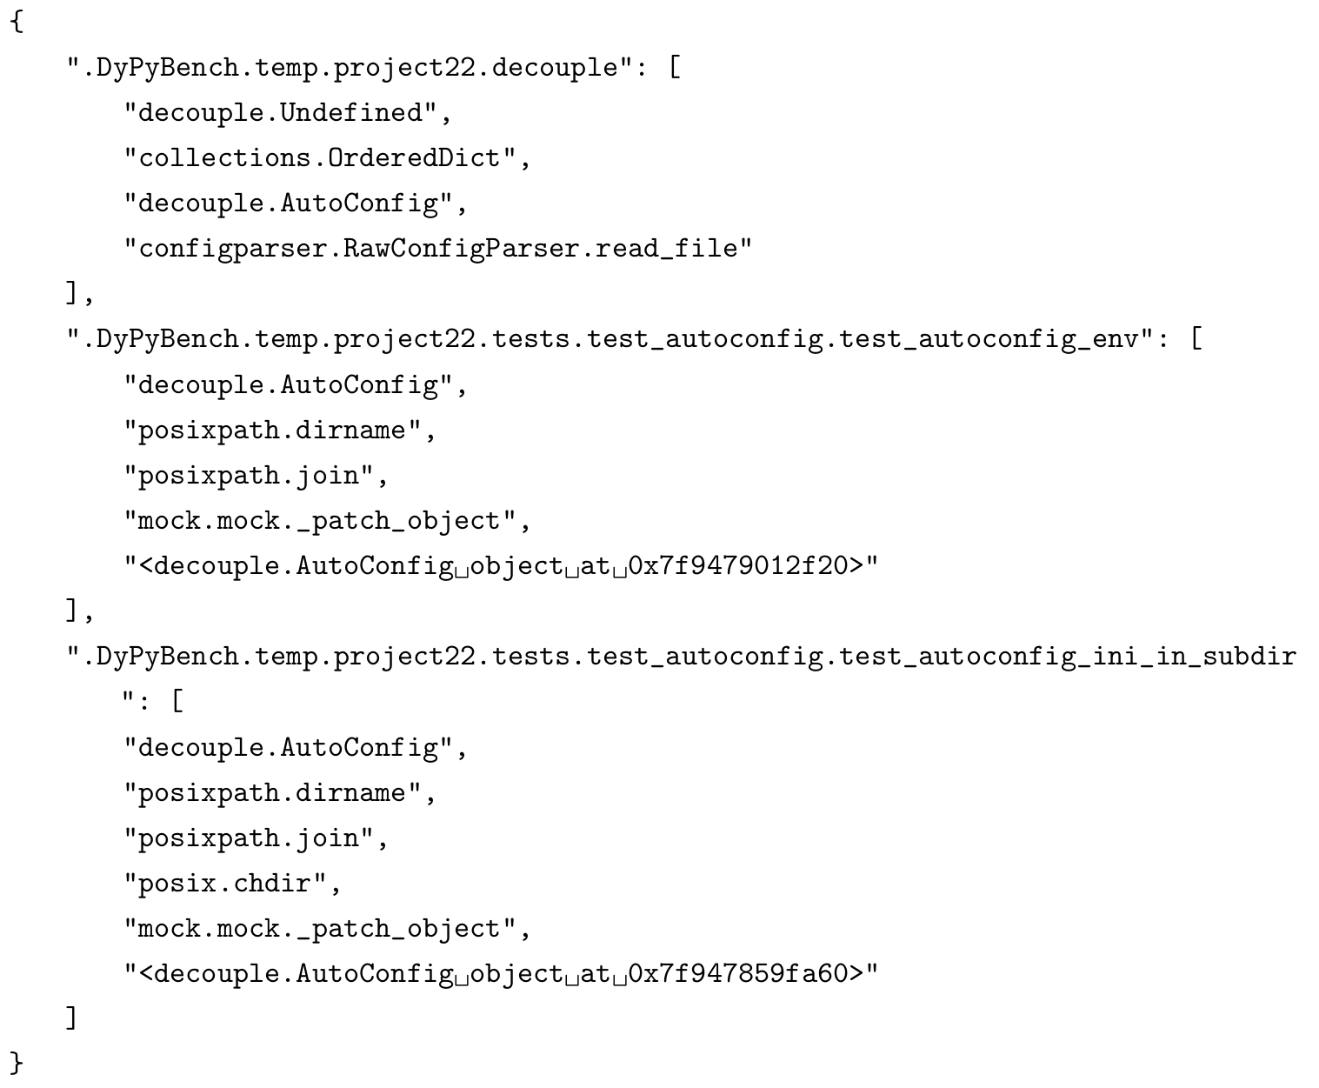
Approach : Integrating Tools (3)
DynaPyt
A generic dynamic analyses framework for Python using run-time hooks.
We generate dynamic call graphs in the form of JSON file.
Caller functions act as key and callees act as values.
Two steps:
Instrumentation of files.
Execution of analysis.
Command for each step in a separate bash file.
Instrumentation files or directory provided via text file.

Slide 20
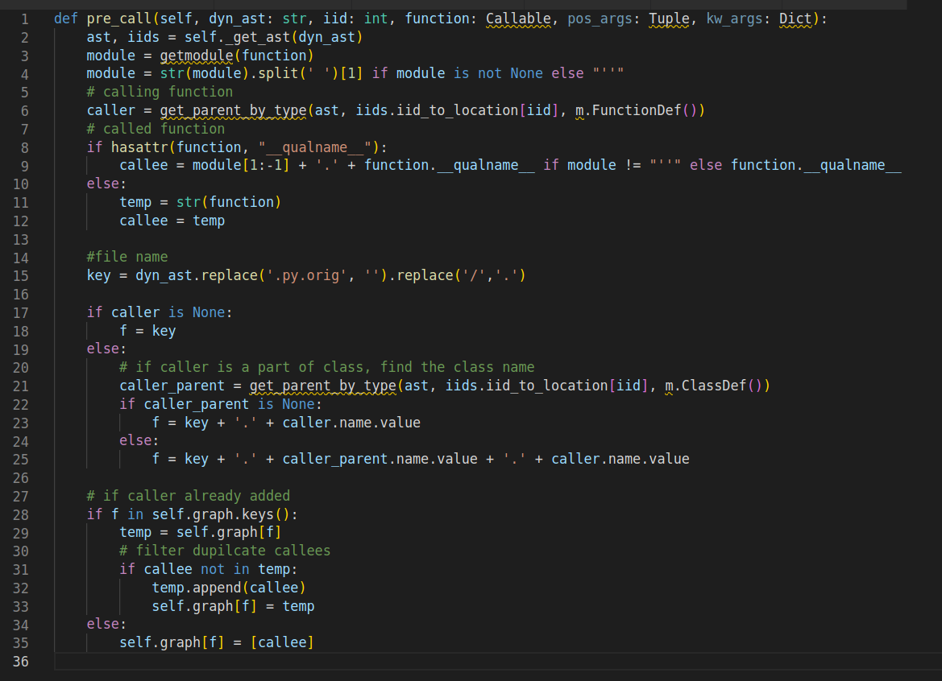
Call Graph Analysis
Function pre call hook implementation in DynaPyt.

Slide 21
Approach : Access Interface (1)
Python script executable from command-line.
Specify options to perform selective task.
Specify all or subset of projects for the task.
Specify output file.
Specify timeout for task.
Specify input for analyses.

Slide 22
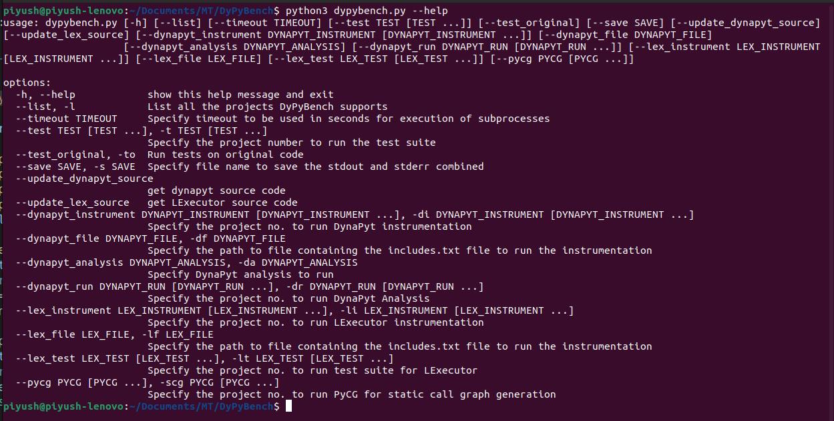
Approach : Access Interface (2)

Slide 23

Approach : Packaging and Export (1)
Docker Image of size 7.07 GB
Publicly available.
Built on Ubuntu with required system dependencies.
Contains projects and analyses tools.
Ready-to-run and ready-to-analyze with access interface.

Slide 24
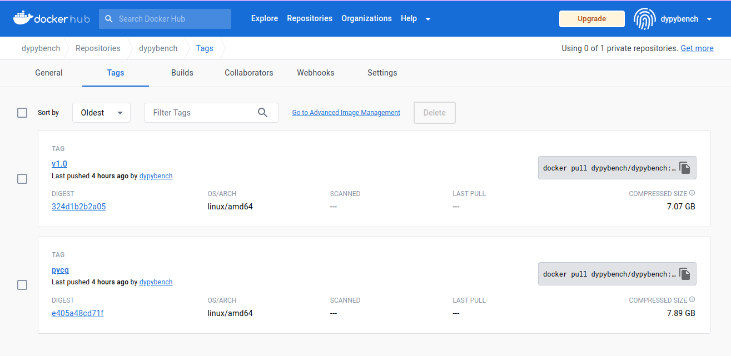
Approach : Packaging and Export (2)
DyPyBench on Docker Hub

Slide 25
Approach
Usage of DyPyBench
Selection Criteria
Test Suite,
Diverse domains,
GitHub stars
Installation of Projects
Automation,
Environments,
Requirements
Integrating Analysis Frameworks and
LExecutor
DynaPyt,
PyCG
LExecutor
Trace File Generation
DynaPyt
Dynamic Analysis
Corpus of Python projects Awesome Python
List of Python Projects
GitHub URLs,
flags
Execution Environment
Installed Projects
Access Interface
List Projects, Run Tests, Run Analysis
Static
Call Graphs
PyCG
DyPyBench

Slide 26
Evaluation
RQ1 : How do the included test suites in Python projects within DyPyBench contribute to a dynamic benchmark?
Statistical analysis of test suites.
RQ2 : How efficient is our benchmark to generate (valid and good) training data for the neural models?
Number of data points collected and the validation accuracy of the model.
RQ3 : How effective is DyPyBench in providing data to aid a comparison of static and dynamic call graph?
Statistical comparison of static and dynamic call graphs.

Slide 27
Evaluation : RQ1
Total number of tests : 45086
Pass percentage : 91.93%
Average tests per project : 902
Total run time of test suites : 3568.86 seconds
Average run time of test suite per project : 71.38 seconds
Low Runtime + High Pass Percentage of Tests = Dynamism for Benchmark

Slide 28
Evaluation : RQ2 (1)
Application example of LExecutor
Number of data points collected : 547830
% increase compared to base data points : 242%
3 validation data sets :
Random split : 5% data points from collected data points.
Project split : 6 projects not included in training, nearly 5% data points.
Original data : Validation data used LExecutor
Accuracy range of the model for Top-1 : 71.86% to 93.67%
Large Quantity of Data + Good Quality of Data = Valid Data Generator

Slide 29
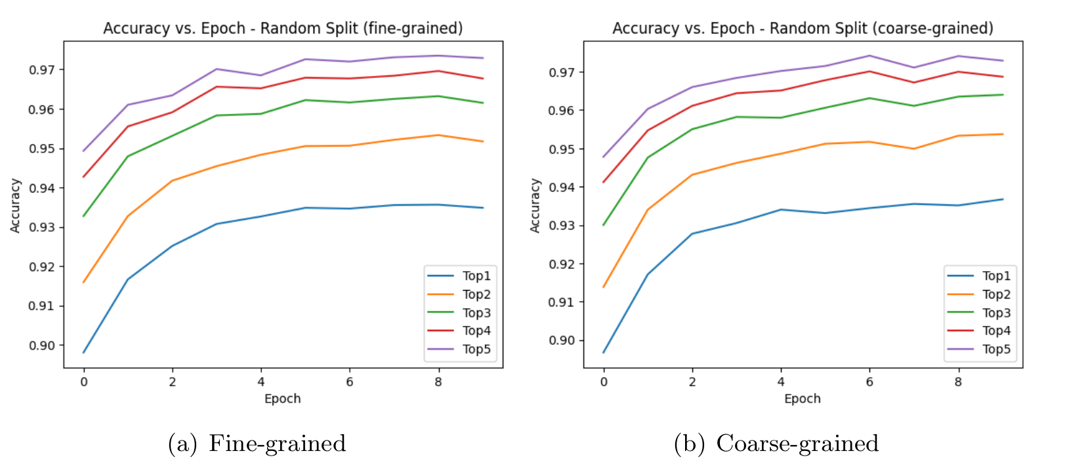
Evaluation : RQ2 (2)
Random Split

Slide 30
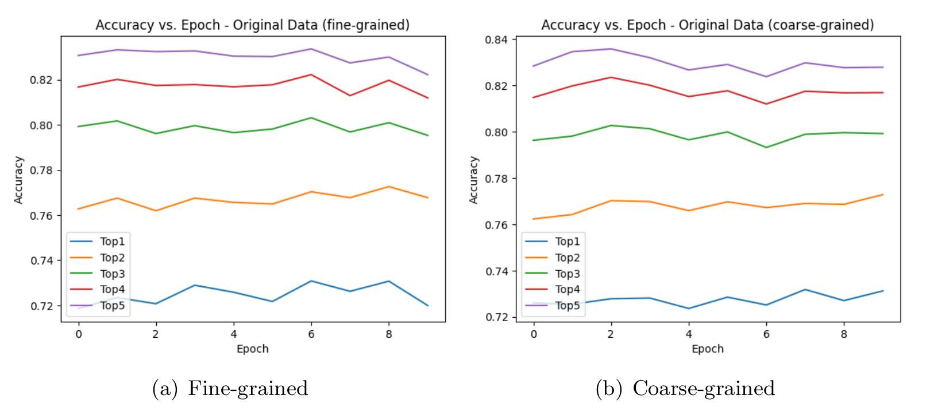
Evaluation : RQ2 (3)
Project Split

Slide 31
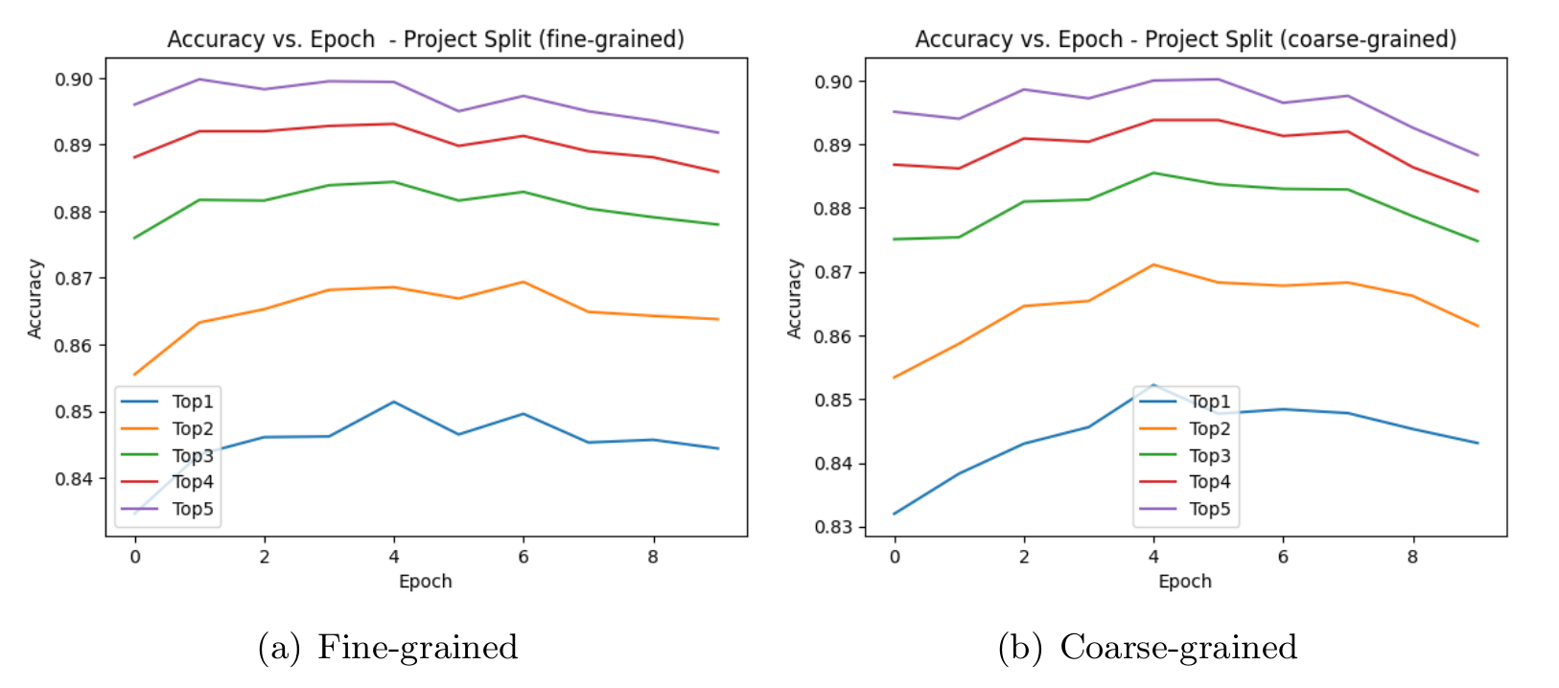
Evaluation : RQ2 (4)
Original Split

Slide 32
Evaluation : RQ3
Application Example of DynaPyt and PyCG.
Total number of caller functions to compare : 10799
Number of matching caller functions : 3147
Total number of callees to compare : 16493
Number of matching callees : 2938
High Number of Callers + High Number of Callees = Good Data Generator for Comparison.

Slide 33
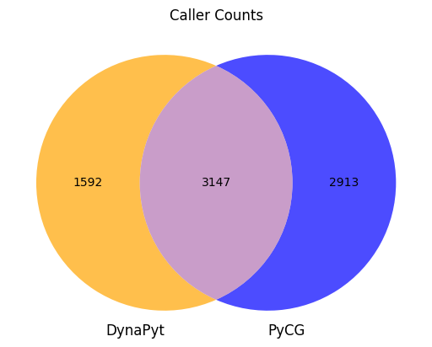

Evaluation : RQ3
Application Example of DynaPyt and PyCG.
Total number of caller functions to compare : 10799
Number of matching caller functions : 3147
Total number of callees to compare : 16493
Number of matching callees : 2938
High Number of Callers + High Number of Callees = Good Data Generator for Comparison.

Slide 34
Conclusion
We create a dynamic Python benchmark containing 50 projects from diverse domains.
The benchmark is preinstalled with code analysis tools such as LExecutor, DynaPyt and PyCG.
The benchmark is capable of providing large and valid data for training neural models.
The benchmark is capable of performing dynamic and static analysis on Python projects to compare the two approaches.
DypyBench is a benchmark framework that can aid research of code analysis tasks in Python.

Slide 35
Thank You

Slide 36
Questions ?

Slide 37
Approach : Packaging and Export (1)
Docker Image of size 7.07 GB
Publicly available.
Built on Ubuntu with required system dependencies.
Contains projects and analyses tools.
Ready-to-run and ready-to-analyze with access interface.

Slide 38

Approach : Integrating Tools (1)
LExecutor
A neural model to predict input values to execute arbitrary code snippets.
We generate training data for the neural model in the form of trace files.
Two steps:
Instrumentation of files.
Execution of test suite.
Command for each step in a separate bash script.
Instrumentation files provided in text file.
Commands

Slide 39
Approach : Execution Environment (2)
Geolocation
Job Scheduler
Data Validation
Web Content Extracting
GraphQL
50 projects in DyPyBench

